Slide 1
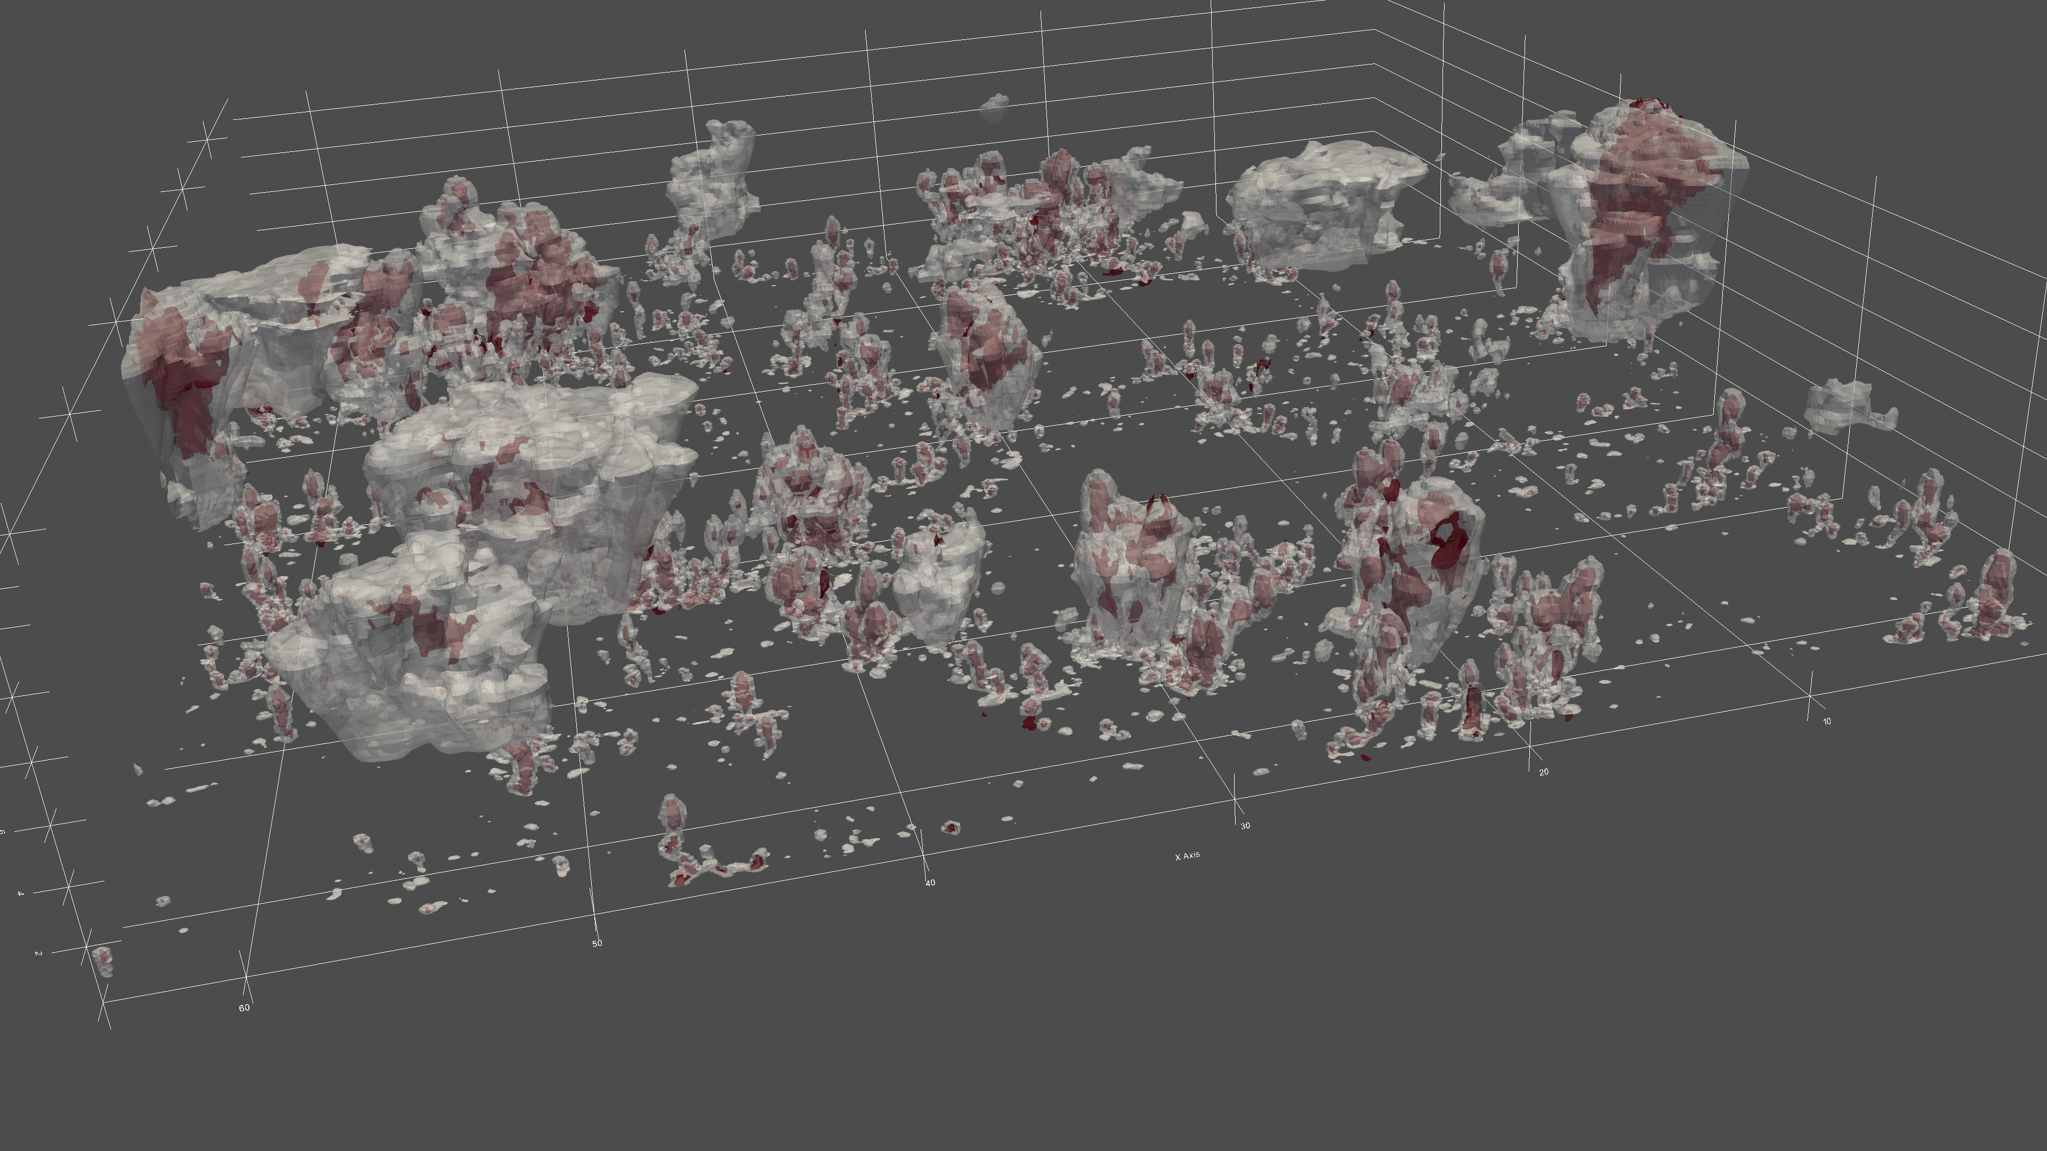
Does Deep Convective Onset Require a Critical Updraft Acceleration?
Scott W. Powell (scott.powell@nps.edu)
Dept. of Meteorology, Naval Postgraduate School, Monterey, CA
10 January 2023
3rd Conference on Mesoscale Processes, 103rd AMS Annual Meeting, Denver, 6.1
This work was supported by the Office of Naval Research Code 32 under grants N0001421WX01472, N0001422WX1021, and N0001423WX00360, and the U.S. Department of Energy Atmospheric System Research, an Office of Science Biological and Environmental Research program, under Interagency Agreement 89243021SSC000077.

Slide 2
Why do we care?
Notes:
Precipitation is related to vertical growth of convection. Larger vertical velocity -> more condensation + freezing -> more hydrometeor growth -> more precipitation. Fundamentally, what controls how much updrafts can grow?

Slide 3
Why do we care?
Cumulus parameterization depends on the thermodynamic properties of atmosphere, makes some questionable assumptions about vertical mass flux, and does poorly at accounting for the life cycle of convection.
Notes:
Precipitation is related to vertical growth of convection. Larger vertical velocity -> more condensation + freezing -> more hydrometeor growth -> more precipitation. Fundamentally, what controls how much updrafts can grow?

Slide 4
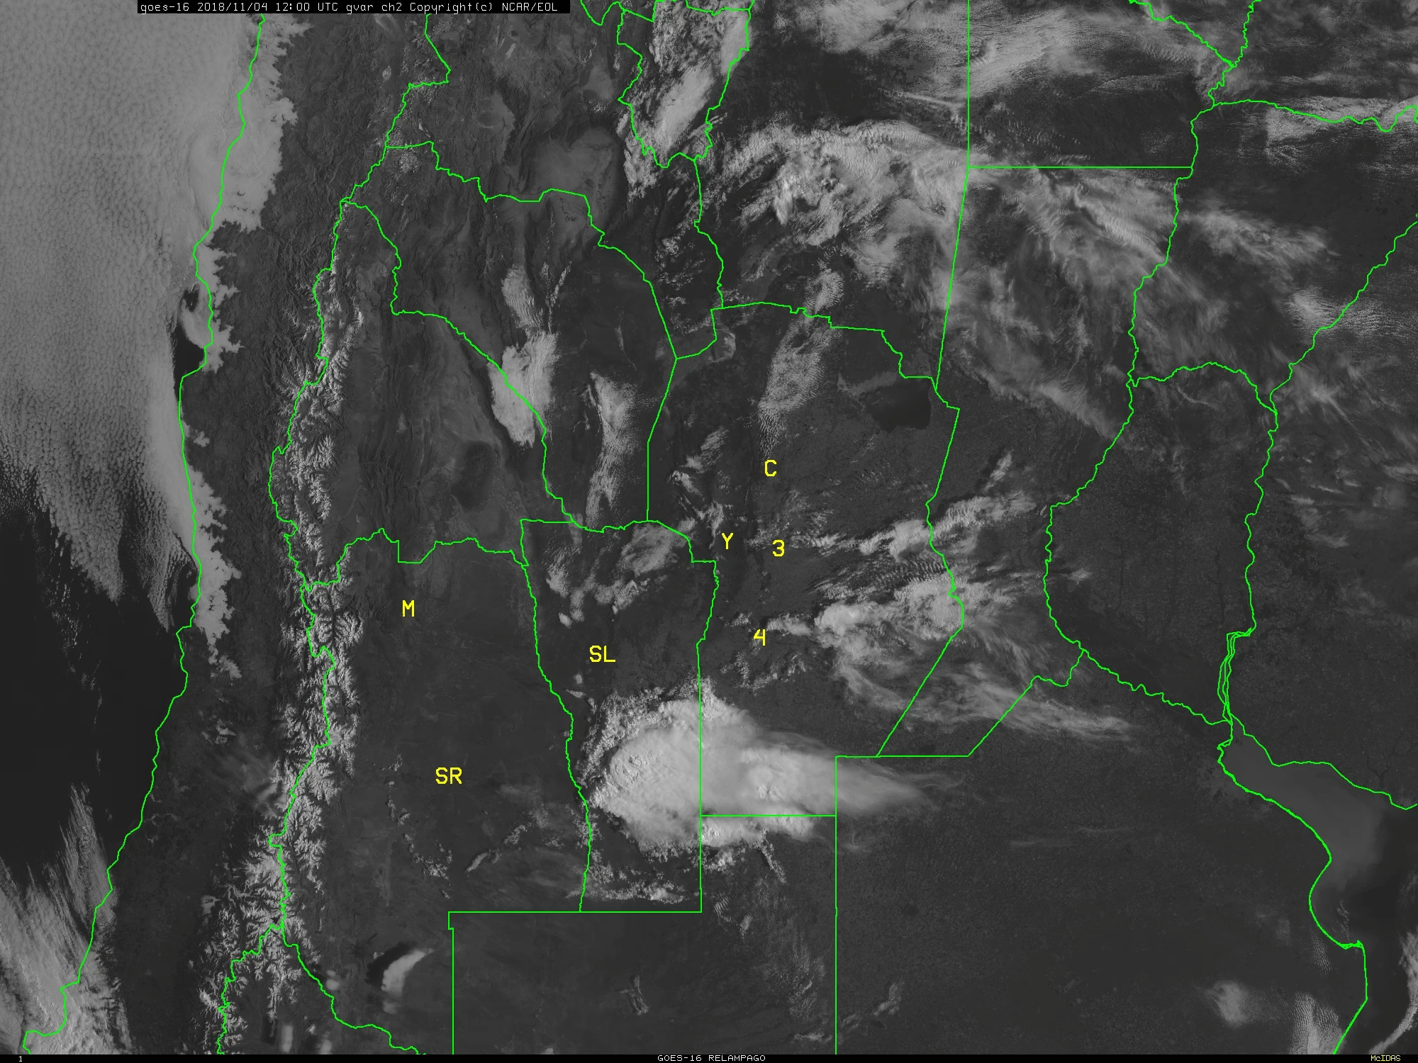
Left) An example of deep convective onset during RELAMPAGO/CACTI.

Slide 5
Left) An example of deep convective onset during RELAMPAGO/CACTI.
Deep convective onset occurs on time and spatial scales of minutes to weeks, but all are impacted by the aggregate behavior of individual clouds.

Slide 6
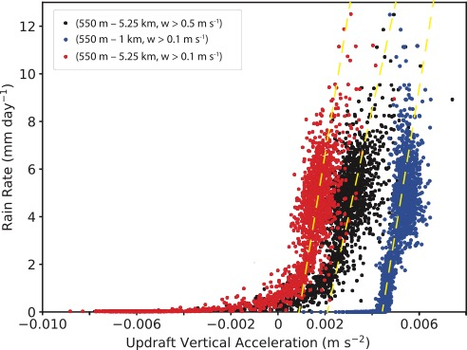
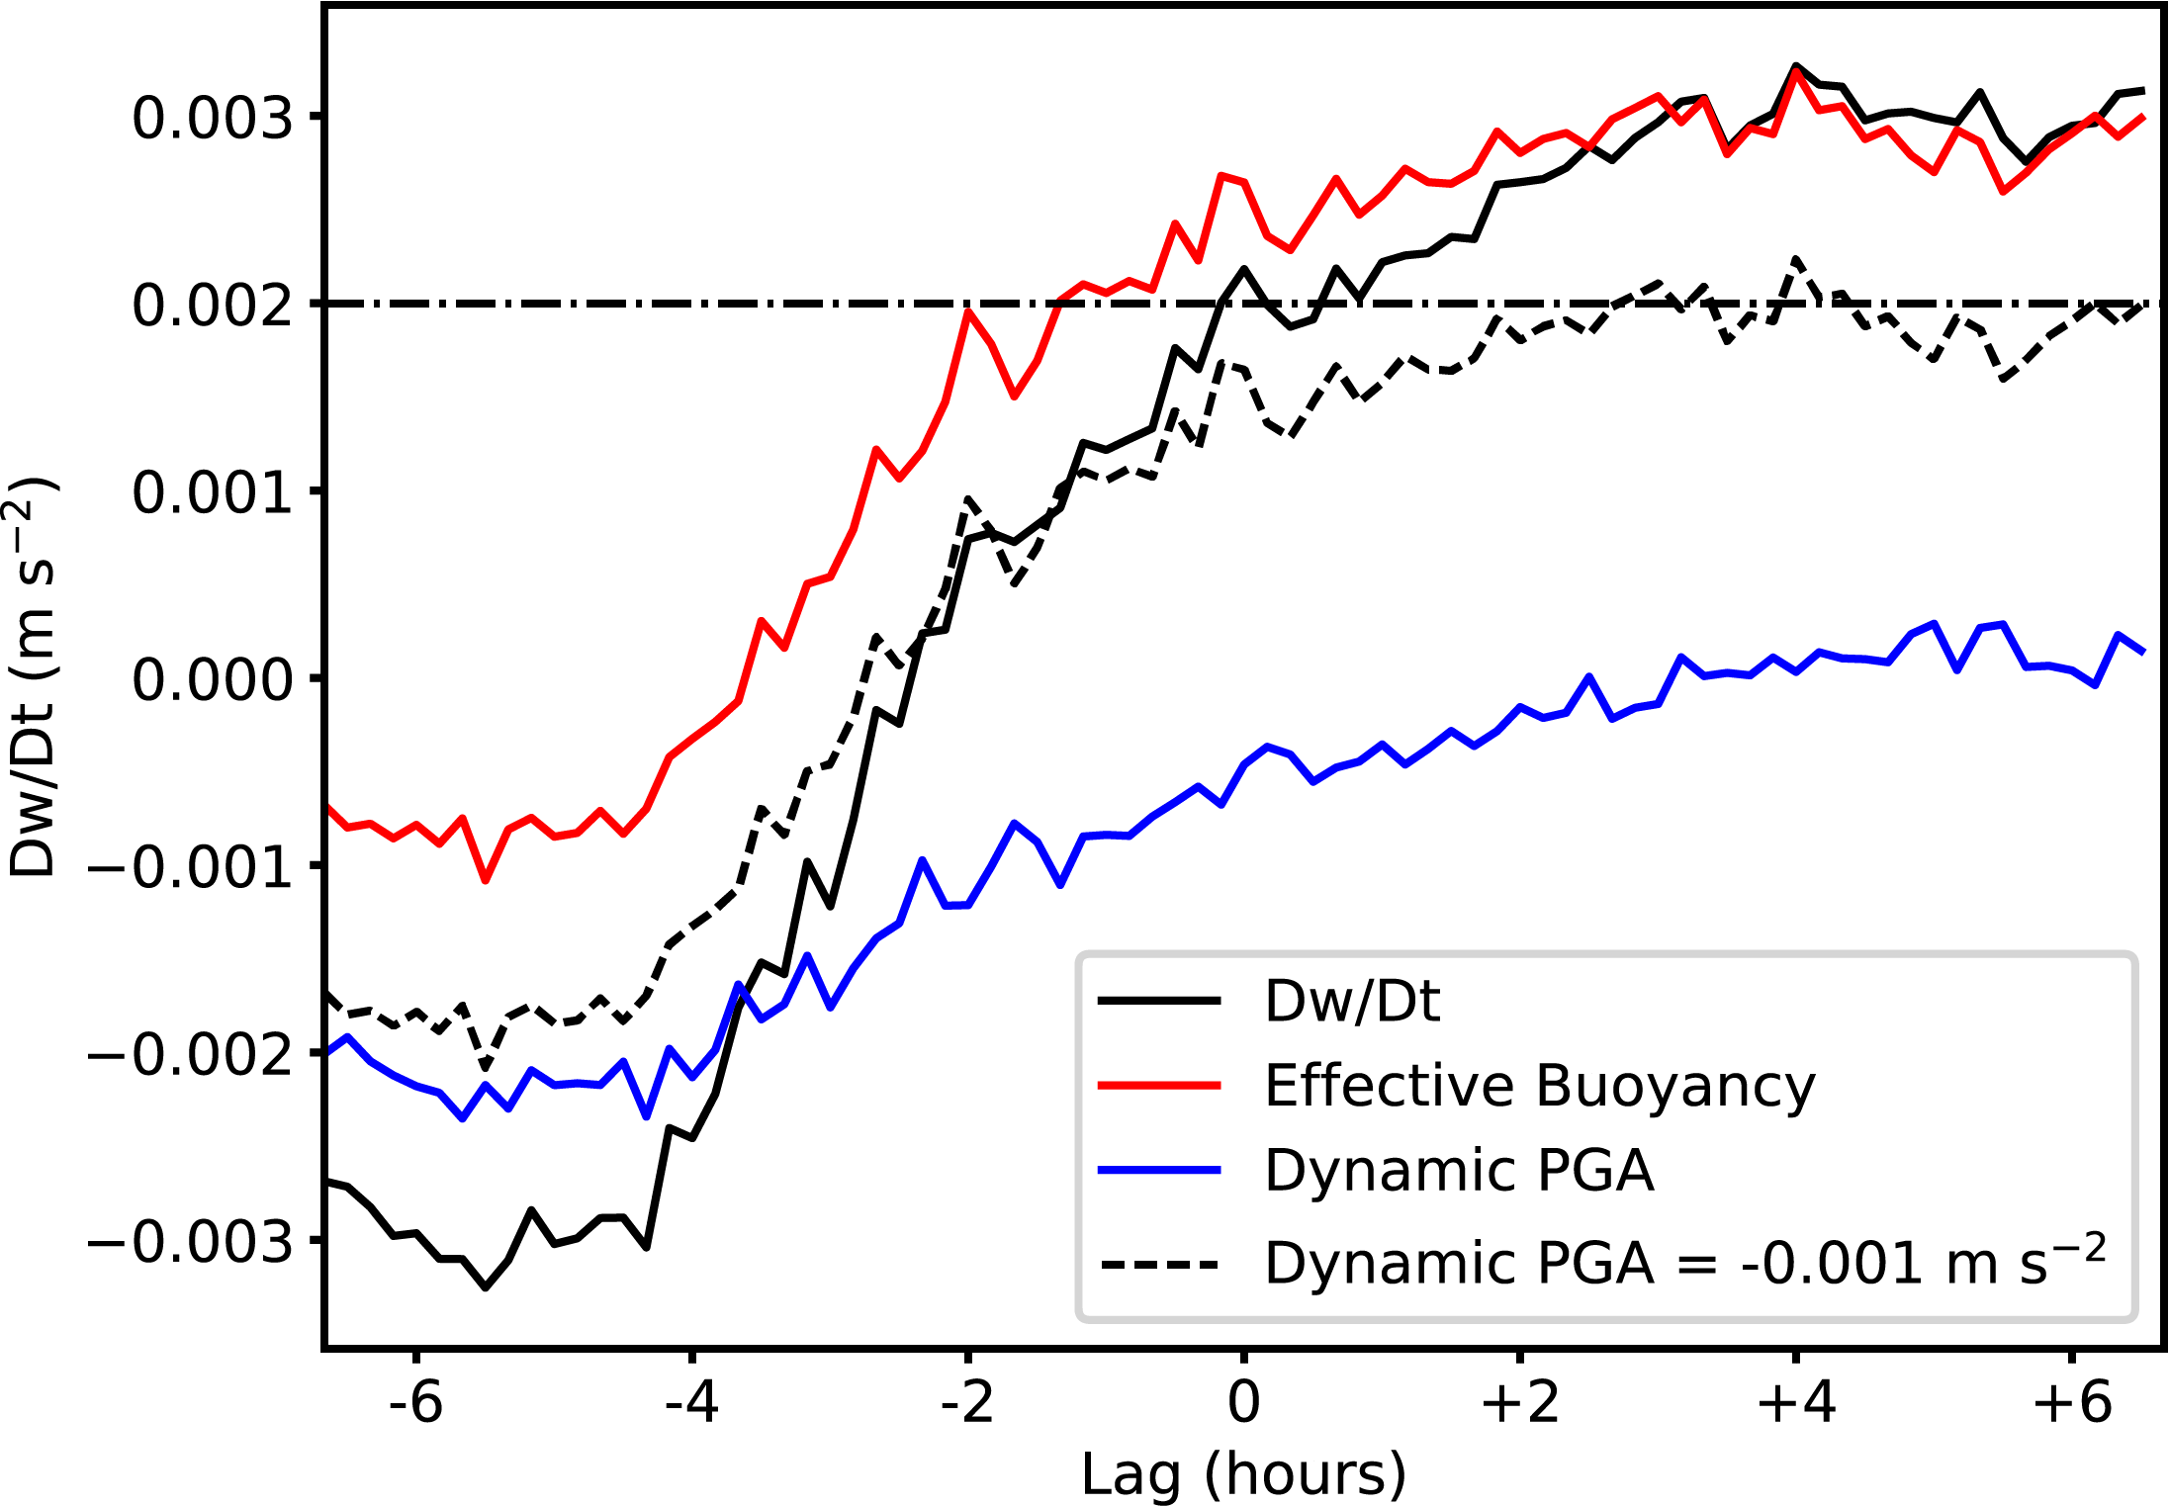
Powell (2022)
Ordinate: CM1 domain mean rain rate
Abscissa: Domain-mean updraft acceleration averaged between various height levels

Slide 7
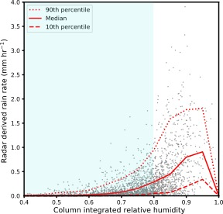
Tropospheric moisture is a necessary condition for deep convection and large rain rates, but by itself is not sufficient.
Radar-derived rain rate vs sonde-derived CRH over tropical oceans
Column-relative humidity of 80% or greater is often considered sufficiently moist for widespread deep convection to occur, but rain rates in such an environment can range from very large to near zero!
Large rain rates averaged over an area much larger than an individual cloud cannot occur if the atmosphere is too dry.
Powell (2019)

Slide 8
Powell (2022)
Ordinate: CM1 domain mean rain rate
Abscissa: Domain-mean updraft acceleration averaged between various height levels

Slide 9
Powell (2022)
Ordinate: CM1 domain mean rain rate
Abscissa: Domain-mean updraft acceleration averaged between various height levels

Slide 10
What controls individual updrafts?

Slide 11
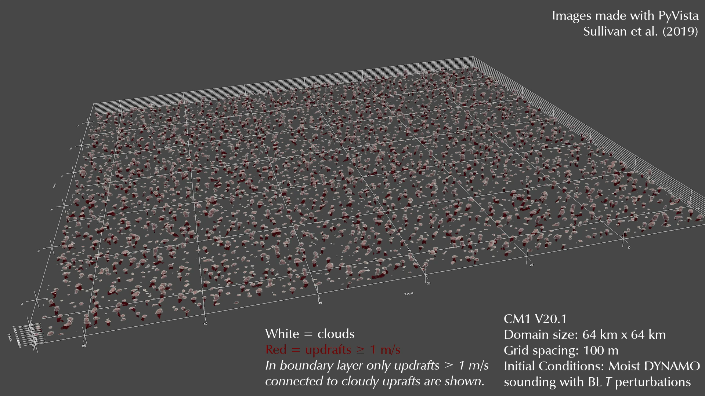
Tropical Ocean

Slide 12
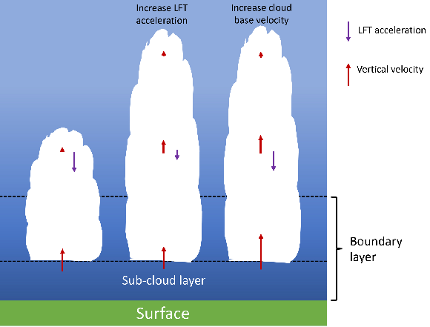
Which clouds grow vs. do not grow?
Do growers have larger initial w or do they experience more upward/less downward acceleration (or both)?
This is extremely challenging to answer with observations alone (although techniques like photogrammetry can help some within limited volumes).
If Dw/Dt is most important, we would like to decompose it to determine what causes downward acceleration.

Slide 13
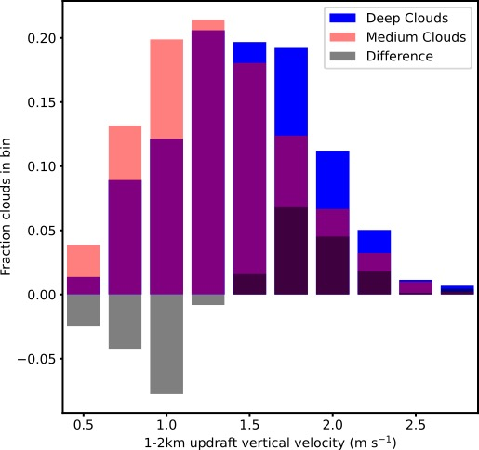
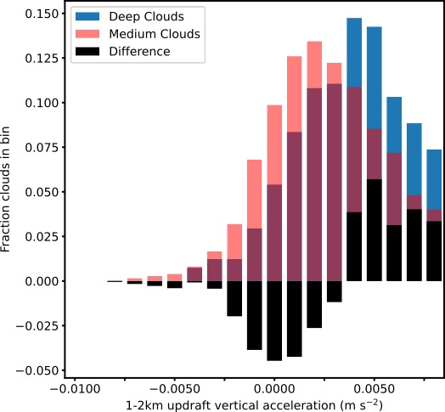
Tropical Ocean
1–2 km Vertical Velocity
1–2 km Vertical Updraft Acceleration
Medium/Shallow: Reaches up to 2–3 km
Deep: Reaches above to 6 km
W and Dw/Dt for big versus not big clouds in each simulation.
Not tracking though!
Some not big clouds could get big later!
What about statistics of clouds themselves (e.g., radius).
Still need to decompose vertical pressure gradient for large domains into individual terms.

Slide 14
Acceleration
600m
Remains Shallow Convection
Grows into Deep Convection
Medium/Shallow: Reaches up to 2–3 km
Deep: Reaches above to 6 km

Slide 15
Acceleration
1000m
Remains Shallow Convection
Grows into Deep Convection
Medium/Shallow: Reaches up to 2–3 km
Deep: Reaches above to 6 km

Slide 16
Acceleration
1500m
Remains Shallow Convection
Grows into Deep Convection
Medium/Shallow: Reaches up to 2–3 km
Deep: Reaches above to 6 km

Slide 17
Acceleration
2000m
Remains Shallow Convection
Grows into Deep Convection
Medium/Shallow: Reaches up to 2–3 km
Deep: Reaches above to 6 km

Slide 18
Acceleration
2500m
Remains Shallow Convection
Grows into Deep Convection
Medium/Shallow: Reaches up to 2–3 km
Deep: Reaches above to 6 km

Slide 19
Acceleration
3000m
Remains Shallow Convection
Grows into Deep Convection
No cloud
Medium/Shallow: Reaches up to 2–3 km
Deep: Reaches above to 6 km

Slide 20
Vertical Velocity

Slide 21
Vertical Velocity
600m
Remains Shallow Convection
Grows into Deep Convection
Medium/Shallow: Reaches up to 2–3 km
Deep: Reaches above to 6 km

Slide 22
Vertical Velocity
1000m
Remains Shallow Convection
Grows into Deep Convection
Medium/Shallow: Reaches up to 2–3 km
Deep: Reaches above to 6 km

Slide 23
Vertical Velocity
1500m
Remains Shallow Convection
Grows into Deep Convection
Medium/Shallow: Reaches up to 2–3 km
Deep: Reaches above to 6 km

Slide 24
Vertical Velocity
2000m
Remains Shallow Convection
Grows into Deep Convection
Medium/Shallow: Reaches up to 2–3 km
Deep: Reaches above to 6 km

Slide 25
Vertical Velocity
2500m
Remains Shallow Convection
Grows into Deep Convection
Medium/Shallow: Reaches up to 2–3 km
Deep: Reaches above to 6 km

Slide 26
Vertical Velocity
3000m
Remains Shallow Convection
Grows into Deep Convection
No cloud
Medium/Shallow: Reaches up to 2–3 km
Deep: Reaches above to 6 km

Slide 27
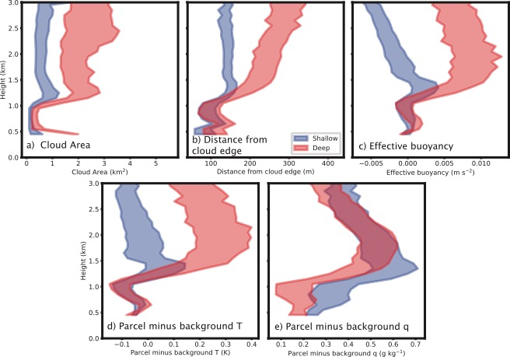

Slide 29
Conclusions
Across a population of clouds, an average updraft acceleration at low levels appears to be required for deep convective onset.
Among individual clouds, deeper growing clouds contain larger accelerations at 1-2 km than shallow, mostly non-precipitating clouds.
Deeper growing clouds start off (presumably out of the atmospheric boundary layer) larger than shallow clouds and grow wider at a much faster rate than clouds that do not become deep.

Slide 30

Vertical Momentum Equation
$$\frac{Dw}{Dt}≈−\frac{1}{ρ}\frac{∂p^{′}}{∂z}+B$$

Slide 31

Vertical Momentum Equation
$$\frac{Dw}{Dt}≈−\frac{1}{ρ}\frac{∂p^{′}}{∂z}+B$$
Archimedean buoyancy
$$B≈\frac{θ^{∗}}{θ_{0}}+\left(\frac{R_{v}}{R_{d}}−1\right)q_{v}^{∗}−q_{lf}$$

Slide 32

Vertical Momentum Equation
$$\frac{Dw}{Dt}≈−\frac{1}{ρ}\frac{∂p^{′}}{∂z}+B$$
Archimedean buoyancy
$$B≈\frac{θ^{∗}}{θ_{0}}+\left(\frac{R_{v}}{R_{d}}−1\right)q_{v}^{∗}−q_{lf}$$
$$\frac{Dw}{Dt}≈−\frac{1}{ρ}\frac{∂p_{D}^{′}}{∂z}−\frac{1}{ρ}\frac{∂p_{B}^{′}}{∂z}+B$$

Slide 33
Vertical Momentum Equation
$$\frac{Dw}{Dt}≈−\frac{1}{ρ}\frac{∂p^{′}}{∂z}+B$$
Archimedean buoyancy
$$B≈\frac{θ^{∗}}{θ_{0}}+\left(\frac{R_{v}}{R_{d}}−1\right)q_{v}^{∗}−q_{lf}$$
$$\frac{Dw}{Dt}≈−\frac{1}{ρ}\frac{∂p_{D}^{′}}{∂z}−\frac{1}{ρ}\frac{∂p_{B}^{′}}{∂z}+B$$
Vertical Pressure Gradient Accelerations

Slide 34
Vertical Momentum Equation
$$\frac{Dw}{Dt}≈−\frac{1}{ρ}\frac{∂p^{′}}{∂z}+B$$
Archimedean buoyancy
$$B≈\frac{θ^{∗}}{θ_{0}}+\left(\frac{R_{v}}{R_{d}}−1\right)q_{v}^{∗}−q_{lf}$$
$$\frac{Dw}{Dt}≈−\frac{1}{ρ}\frac{∂p_{D}^{′}}{∂z}−\frac{1}{ρ}\frac{∂p_{B}^{′}}{∂z}+B$$
“Effective buoyancy”
Vertical Pressure Gradient Accelerations

Slide 35
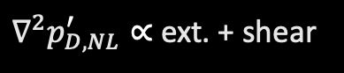
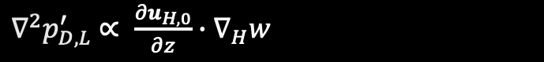

Vertical Momentum Equation
$$\frac{Dw}{Dt}≈−\frac{1}{ρ}\frac{∂p^{′}}{∂z}+B$$
Archimedean buoyancy
$$B≈\frac{θ^{∗}}{θ_{0}}+\left(\frac{R_{v}}{R_{d}}−1\right)q_{v}^{∗}−q_{lf}$$
$$\frac{Dw}{Dt}≈−\frac{1}{ρ}\frac{∂p_{D}^{′}}{∂z}−\frac{1}{ρ}\frac{∂p_{B}^{′}}{∂z}+B$$
Vertical gradient of dynamic perturbation pressure. Can be further separated into linear and nonlinear components:
$$−\frac{1}{ρ}\frac{∂p_{D}^{′}}{∂z}=−\frac{1}{ρ}\frac{∂p_{D,L}^{′}}{∂z}−\frac{1}{ρ}\frac{∂p_{D,NL}^{′}}{∂z}$$
$∇^{2}p_{D,L}^{′}$ $∝ \frac{{∂u}_{H,0}}{∂z}∙∇_{H}w$
Vertical Pressure Gradient Accelerations
$∇^{2}p_{D,NL}^{′}∝$ ext. + shear

Slide 36
Vertical Velocity
500m
Remains Shallow Convection
Grows into Deep Convection

